Slide 1
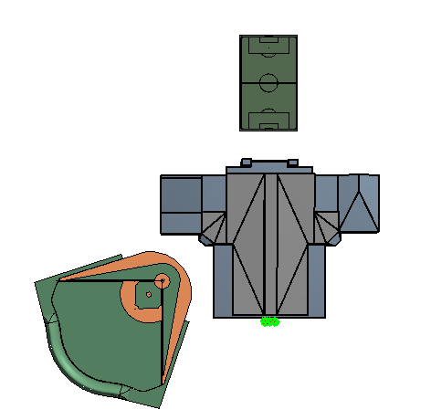
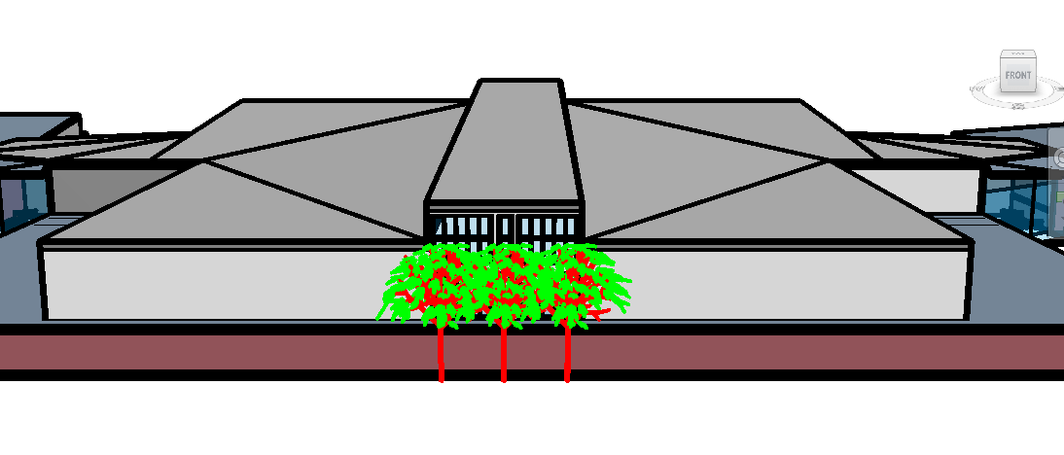
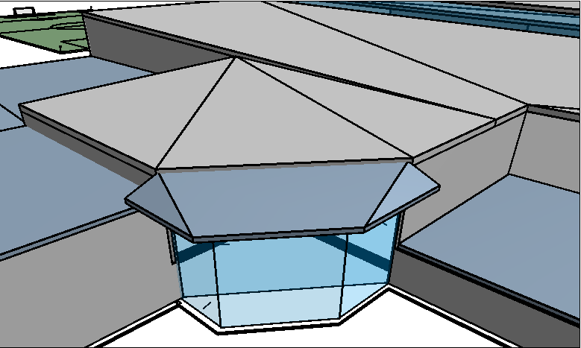
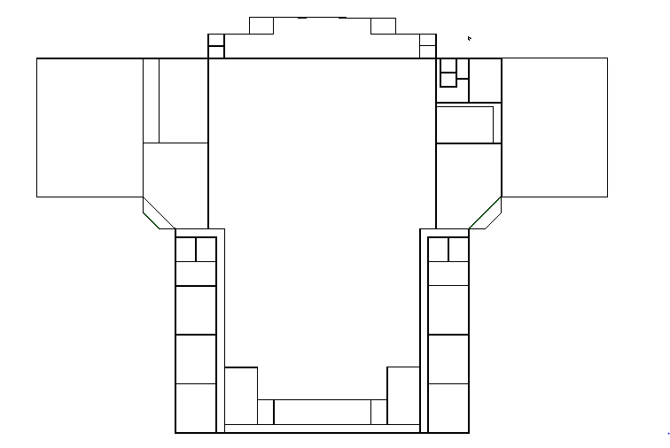
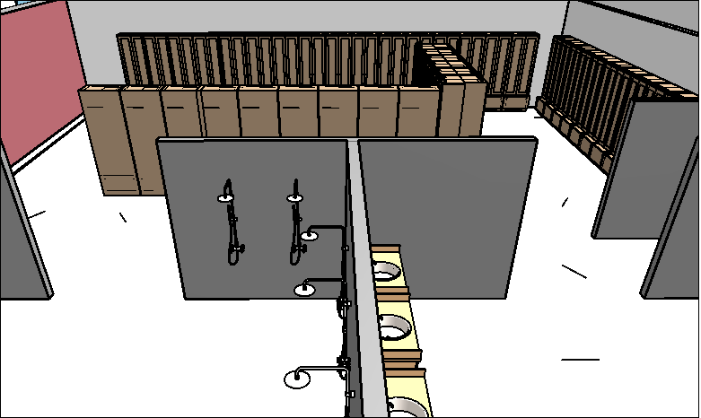
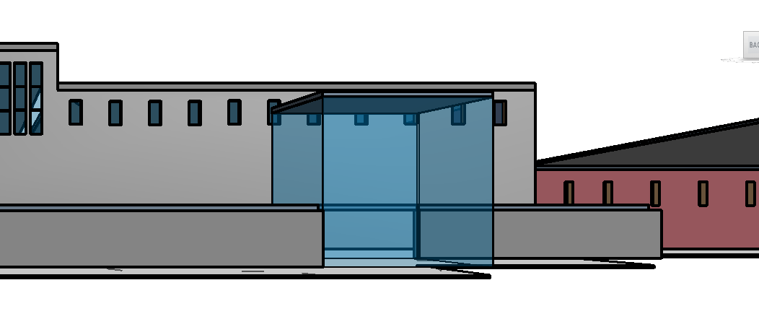
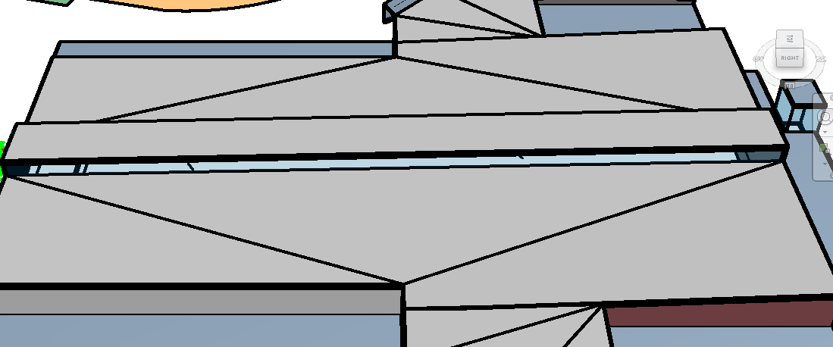
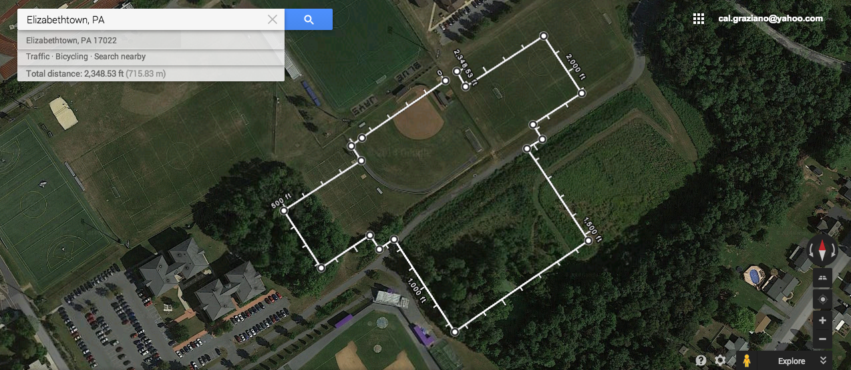
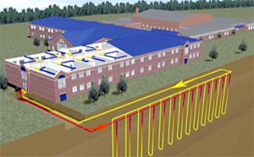
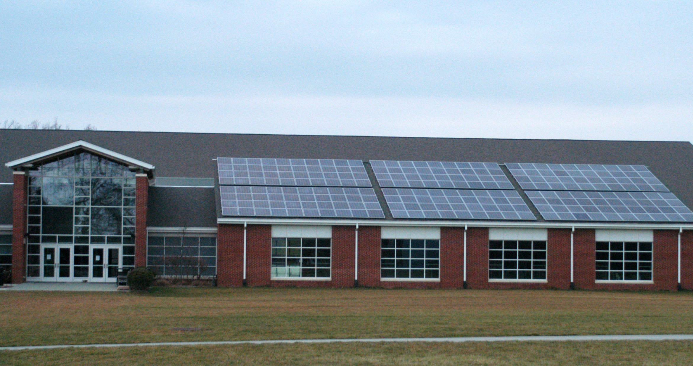
NCCA regulation track
8 locker rooms
Trainer’s room
Equipment room
Laundry loop room
Weight room
2 multipurpose room
3 Offices
Large lobbies, social space
A turf room
6 Bathrooms
Basketball Court Wing
KAV/weight Room Wing
Counseling rooms
Spacious walkway/overlook
2 Cafes
Wellness Center Design Proposal
Elizabethtown College
Brynne Kirsch, Cal Graziano, Sarah Fay
EGR 343: Green Architectural Engineering
LEED Support
Floor Plan
Front Lobby
Equip.
Multi-purpose Room
Basketball Courts Wing
Turf
KAV/Weight Room Wing
Equip
Lobby
NCAA 200m Track and Field
Lobby
Laundry
Laundry
L
O
C
K
E
R
R
O
O
M
S
L
O
C
K
E
R
R
O
O
M
S
LOCKER
LOCKER
Trainer Room

Slide 2
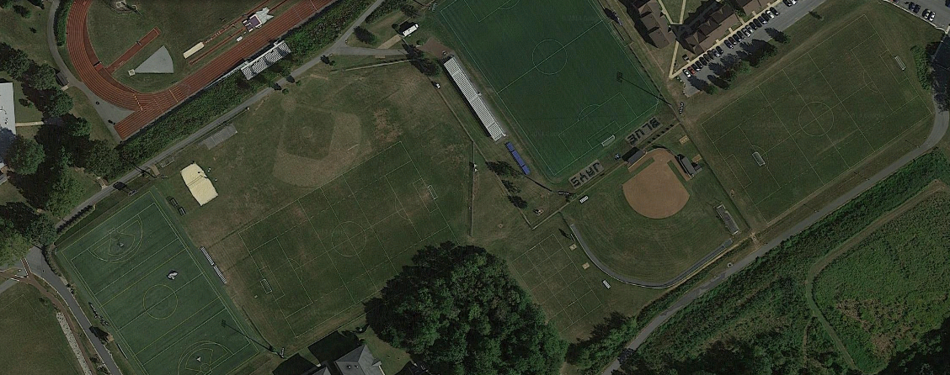
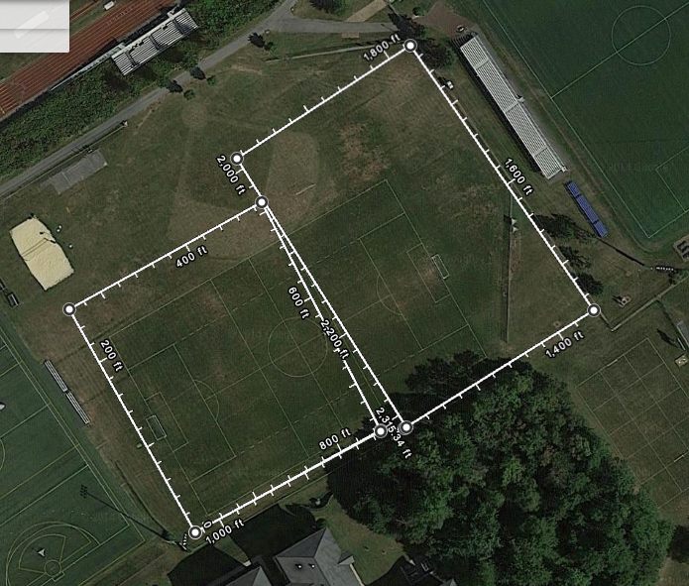
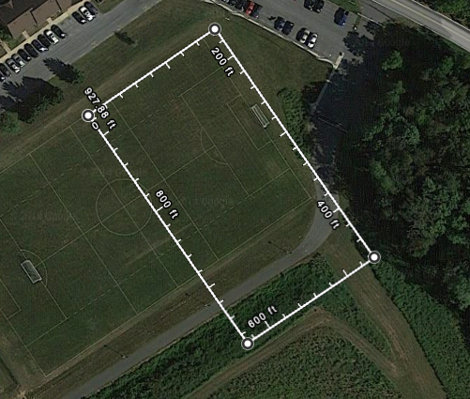
Before
Soccer Varsity Field
“Quad” soccer practice field
“Baseball” soccer practice field
Softball Varsity Field
Turf Multiuse Field
After
“Baseball” Soccer Practice Field
“Quad” Soccer Practice Field
Softball Varsity Field

Slide 3
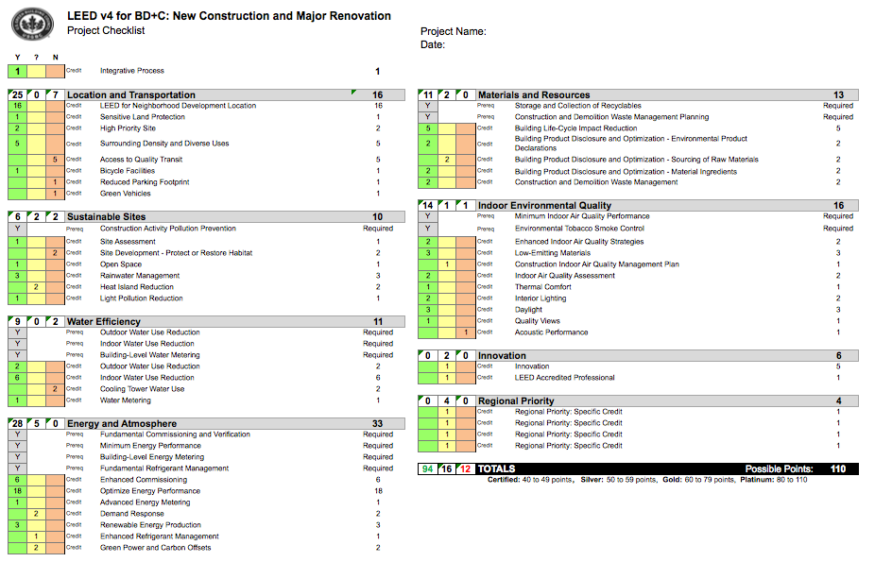
Elizabethtown College Wellness Center

